Slide 1

What to keep and where to keep it 20th January 2016
Jonathan Rans
Digital Curation Centre
This work is licensed under the Creative Commons Attribution 2.5 UK: Scotland License.

Slide 2
Why not keep it all?
Globally, data volumes are doubling every two years
John Gantz and David Reinsel 2011 Extracting Value from Chaos www.emc.com/digital_universe.

Slide 3
Data volumes escalate
Volumes rising faster in data-intensive research domains
e.g. DNA sequence data is doubling every 6-8 months
“ELIXIR and Open Data” View from an ELIXIR Node” Barend Mons, ELIXIR Launch event, 18th Dec 2013

Slide 4
Storage mgmt costs rise long-term
Hardware costs decline, but power and staff costs keep rising
David Rosenthal blog.dshr.org/2012/05/lets-just-keep-everything-forever-in.html

Slide 5
The storage is cheap fallacy
Decreasing hardware costs offset by data volume growth
Backup and mirroring multiplies cost of preserved data
Discovery becomes harder as chaff outweighs the wheat
Curation of unused data is a waste of resources

Slide 6
Storage Strategies
Good practice
Weigh up risks,
Value, and costs
Select, share, safeguard
what you can afford to, or dispose of it
Findable
Accessible
Interoperable
Reusable
FAIR Principles
www.force11.org/group/fairgroup
Bad practice
Keep everything until…
lost by natural wastage
Fragmented
Risking unauthorised
disclosure or loss
Bit rot
Media degradation
Obsolescence
(software, device,
format, media)
Fire, flood, theft
Organisation failure
Notes:
What are you aiming to do with selection?
Keep data of value in a manner that preserves and amplifies that value

Slide 7
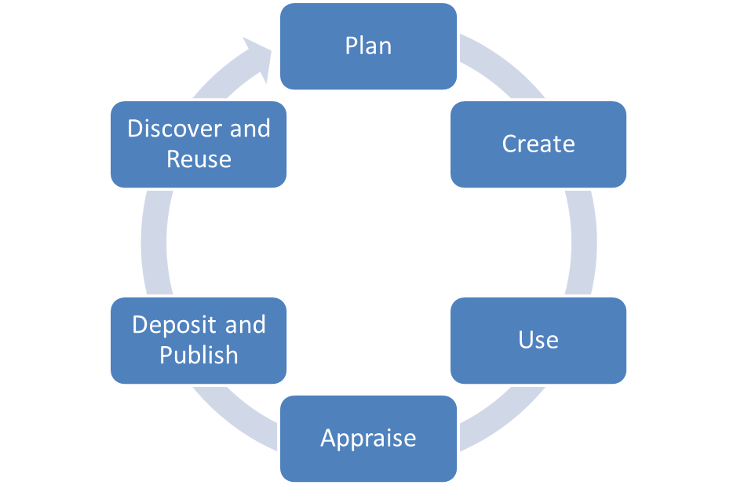
When should selection begin?
Appraisal should begin as early as possible!
Periodically for longitudinal and reference datasets
Notes:
The appraisal process should begin during the planning phase when researchers should be able to provide a general overview of the expected outputs of the project and their potential for reuse. Refining this picture during the project will enable detailed metadata and processing to be carried out on the most relevant and valuable parts of the dataset. The ‘Appraisal’ part of the lifecycle relates to all the data produced by the project which may include some auxiliary material.

Slide 8
Selection questions to answer
What must be kept to manage compliance risk?
What data could be re-used?
What data has value and should be kept?
Given costs what will or won’t be kept?
How will it be kept and shared, on what terms?
Notes:
This final point is an important one – what data is to be shared, what to be preserved and what to be disposed of. There is a good chance that a variety of strategies may need to be applied to data produced by a single project.

Slide 9

What ‘must’ be kept?
Some data may be part of research record, evidence for e.g. …
Supporting patent applications or IP
Evidence of investigations or inquiries
Health & Safety (Lab book)
Compliance also about data that won’t be kept, or may only be shared with approved researchers…
Notes:
Jisc Infonet Guidance on Managing Research Records
tools.jiscinfonet.ac.uk/downloads/bcs-rrs/managing-research-records.pdf
What can’t be kept:
Research Ethics, Duty of Confidentiality, Data Protection Act, Human Rights Act, Statistics & Registration Services Act. UK Data Archive:
http://www.data-archive.ac.uk/create-manage/consent-ethics/legal

Slide 10

What ‘must’ be kept?
What about Funding Body data policies?
“Data with acknowledged long-term value ”
RCUK Common Principles on Data Policy
“Data, information and other electronic resources of long-term interest”
ESRC UK Data Archive Collections Development Policy
“Where data underpins published research there is much greater expectation that it will be kept”
Ben Ryan, EPSRC
Notes:
What counts depends on data’s value for purposes it has served or may serve, so consider these as first step.

Slide 11
What ‘must’ be kept?
Don’t forget Journal policies…
“An inherent principle of publication is that others should be able to replicate and build upon the authors' published claims. Therefore, a condition of publication in a Nature journal is that authors are required to make materials, data and associated protocols promptly available to readers without undue qualifications.
…Nature journals reserve the right to refuse publication in cases where authors do not provide adequate assurances that they can comply with the journal's requirements for sharing materials.
http://www.nature.com/authors/policies/availability.html
Notes:
“Changemakers are journals with high impact factors….Progressive policies are not widespread, but are being adopted rapidly”
Victoria Stodden “Re-use and Reproducibility:Opportunities and Challenges” Open Repositories, 2013

Slide 12
What could be reused?
Step back and reflect – typical reuse purposes
Verification
Further analysis
Reputation building
Resource development
Further publications inc. data articles
Learning and teaching materials
Private reference
Then relative to these, which data must be kept and which data and related materials will have significant value?

Slide 13
e.g. High Energy Physics community
Levels of data to preserve | Reuse purpose
Additional documentation (e.g. wikis, news forums) | Publication-related information search
Data in a simplified format | Outreach, simple training analyses
Analysis level software and the data format | Full scientific analysis based on existing reconstruction
Reconstruction and simulation software and basic level data | Full potential of the experimental data
Adapted from: DPHEP Study Group: Towards a Global Effort for Sustainable Data Preservation in High Energy Physics, May 2012 . http://arxiv.org/abs/1205.4667

Slide 14
What data should have value
Indicators that data have value
Quality of the data and its description
complete, accurate, reliable, valid, representative etc
Demand high
known users, integration potential, reputation, recommendation, appeal
Replication difficulty
difficult, costly, or impossible to reproduce
Low barriers
legal/ ethical, copyright non-restrictive terms and conditions
Rarity
unique copy or other copies at risk
Which related material does data depend on for its value?

Slide 15
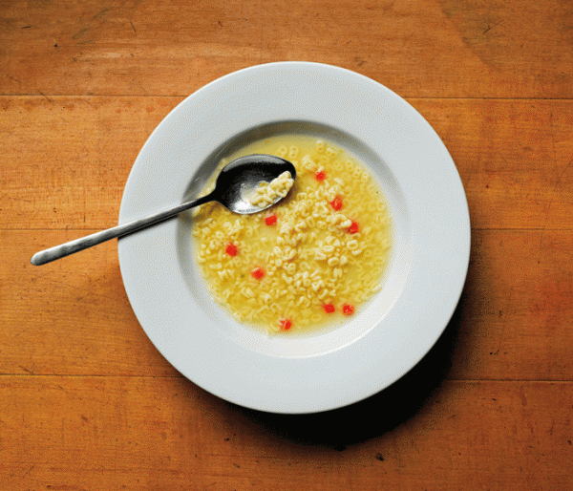
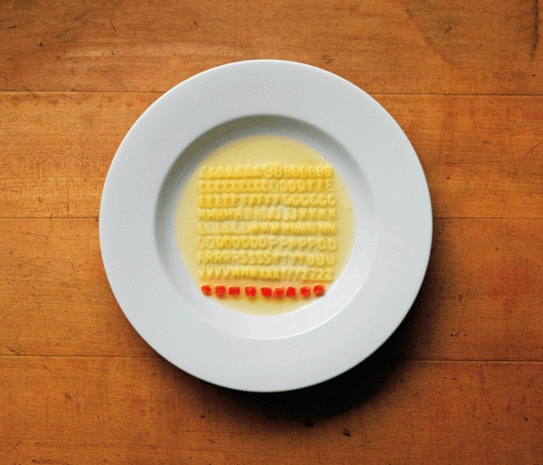
Cost factors
Consider these when deciding what to keep because
Costs incurred during project may add to the data’s value
Need to make sure post-project costs are covered
What action needs to be taken to ensure preservation is costed?
Notes:
Cost factors:
Creation, collection & cleaning
Short-term storage & backup
Short-term access & security
Team communication & development
Preservation & long-term access

Slide 16
Who should help appraise?
RLUK ‘skills gaps’ survey of Subject Librarians & Managers
“ …nine key areas where future involvement by Subject Librarians is considered to be important now and is also expected to grow sharply…
Ability to advise on preserving research outputs (49% see as essential in 2-5 years; 10% now)
Knowledge to advise on data management and curation, (48% essential in 2-5 years; 16% now)…”
Mary Auckland 2012 Reskilling Libraries for Research

Slide 17
Who else?
Others who may be involved in appraising research data…
Domain specialists
Archives
Research Office- Business development
IT Support/ Research Computing
Research Ethics Committee
Records Management/ FOI Compliance
Facilities Managers (if physical samples involved)

Slide 18
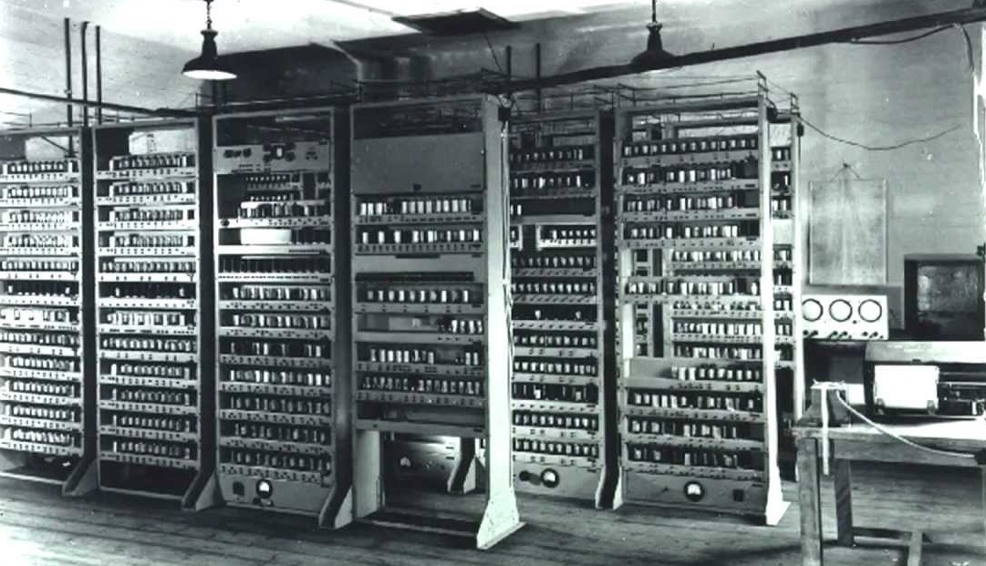
Now the where…

Slide 19
Institutions are providing a range of options
Secure managed storage/disposal
Institutional data catalogue
Institutional data repository
Help to find an external repository
Go
Notes:
Institutions are offering a variety of services that provide options for preserving and exposing data post-project. Which of these it is appropriate to use will depend on the nature of the data the researcher has, most particularly whether it is or isn’t to be made openly available.

Slide 20

What can’t be shared?
Sensitive personal data
Data with IP or Copyright restrictions
Data that is too large to deliver over the network
Physical data
Notes:
Copyright restrictions can be particularly complicated when data has been aggregated or reused.

Slide 21
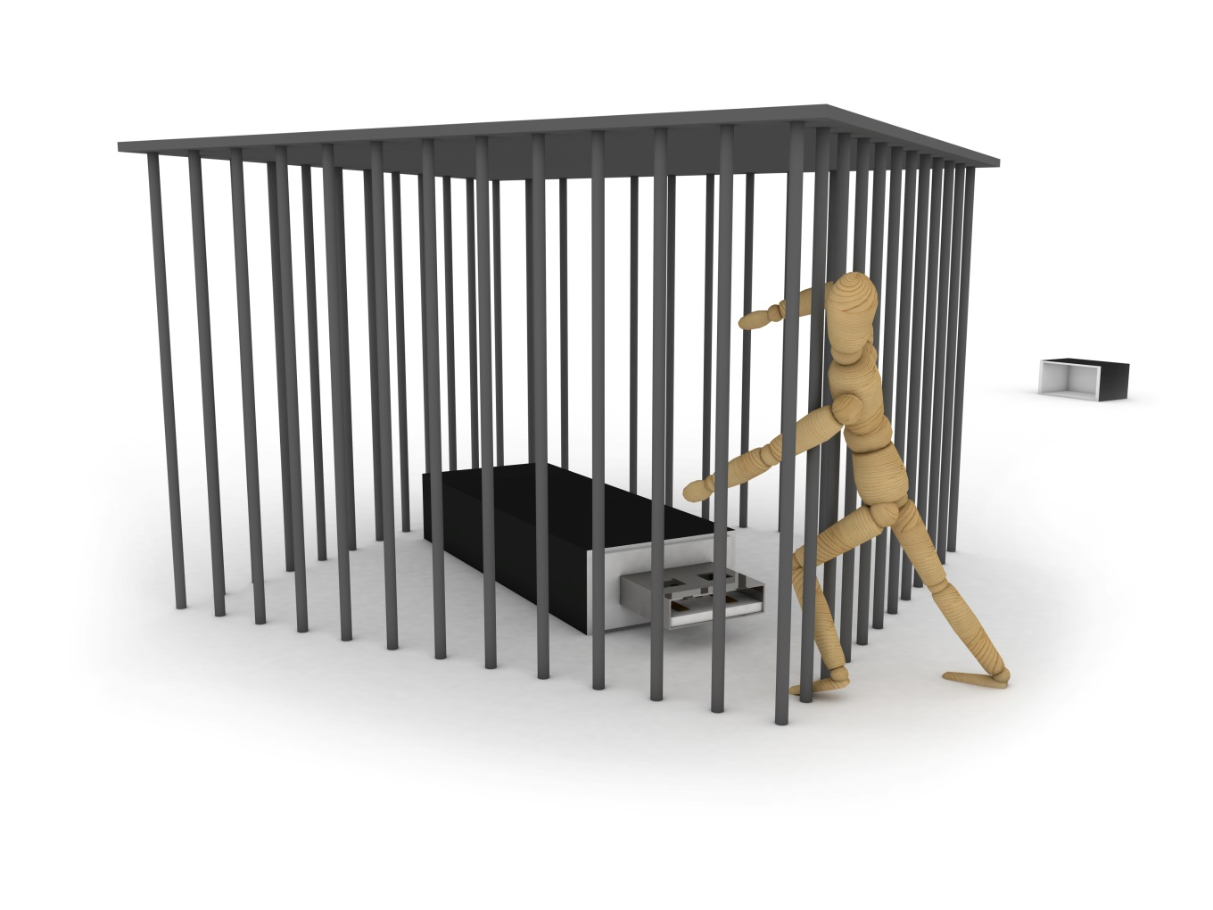
But…
It must be preserved
It must be visible
It may be accessible under certain conditions

Slide 22

Options for closed data
Institutional data archive/vault
Safe havens – (e.g. secure patient data)
3rd party data archiving
Cloud storage
Institutional servers – the ‘do nothing’ option
Apart from exceptional cases it should have a digital presence

Slide 23

Options for open data
Domain repository
General repository – Figshare, Zenodo, Dryad
Institutional repository
Journal supplementary material
Departmental web page
Notes:
Domain best
General – need to ensure it’s suitable for your use
Institutional – will keep data of low value or data with no other home but may not ensure targeted visibility
Journal – fulfils journal requirements but does not offer repo functionality or longevity required by funders
Web page – may target domain academics and allow manipulation of data and support for living datasets. Does not have citability, longevity or engender user trust that the resource is the same as the one described in publications.

Slide 24
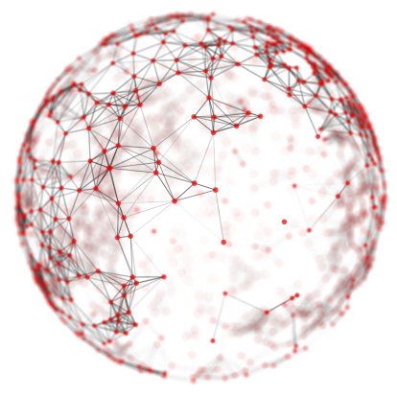
Depositing in multiple locations
A single location may not provide all that is needed
Niche disciplinary repositories may not offer guaranteed longevity
IR may hold prestige datasets
Is it the repository of last resort?

Slide 25
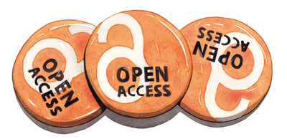
Repository selection

Slide 26
Finding external repositories
Go
General directories
Re3data.org
Domain specific directories
e.g. life sciences – Biosharing.org
Data journal recommendations
Edinburgh research data blog: Sources of dataset peer review
Funding body recommendations
E.g. Wellcome Trust Data repositories and database sources
Notes:
Data journals require that the data being described in articles be freely available and usually mandate where it should be deposited, this can help to identify community-accepted repositories.
Some journals may also offer recommendations for appropriate places to deposit research data

Slide 27

A conversation with the researcher
There may be an accepted repository used by peers or required by funders
Multidisciplinary studies may not have an obvious home
Data types and volumes will impact on decision

Slide 28
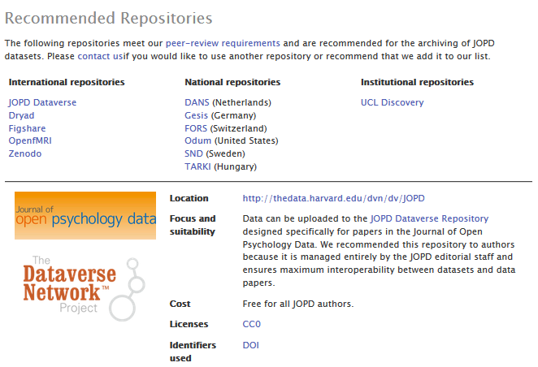
Journal’s guidance
Journal of Open Psychology Data

Slide 29

Finding a repository
Lists over 1300 data repositories
Icons for ease of assessment
Supported by DataCite

Slide 30

DCC guidelines - repositories
Is the repository reputable?
Will it accept the data you want to deposit?
Will data be safe in legal terms?
Will the repository sustain data value?
Will the repository support analysis and track data usage?
Notes:
Will the data be citable? – Is a DOI provided

Slide 31


Any questions?
Jonathan Rans
J.Rans@ed.ac.uk
@JNRans
Images
Open access badges Jim Spencer from www.nature.com
Alphabetti spaghetti from Ursus Wehrli: https://www.kunstaufraeumen.ch/en
Closed data from: http://www.gsma.com

